Slide 1
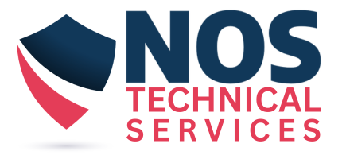




NOS Technical Services
Capabilities Presentation

Slide 2

Addressing Information Technology Needs Globally
NOS Technical Services is a global supplier with years of experience meeting your IT staffing needs. We provide custom staffing solutions focused on Data & Analytics, Cloud Services, Cyber Security, ERP Support and Application Development.

Slide 3
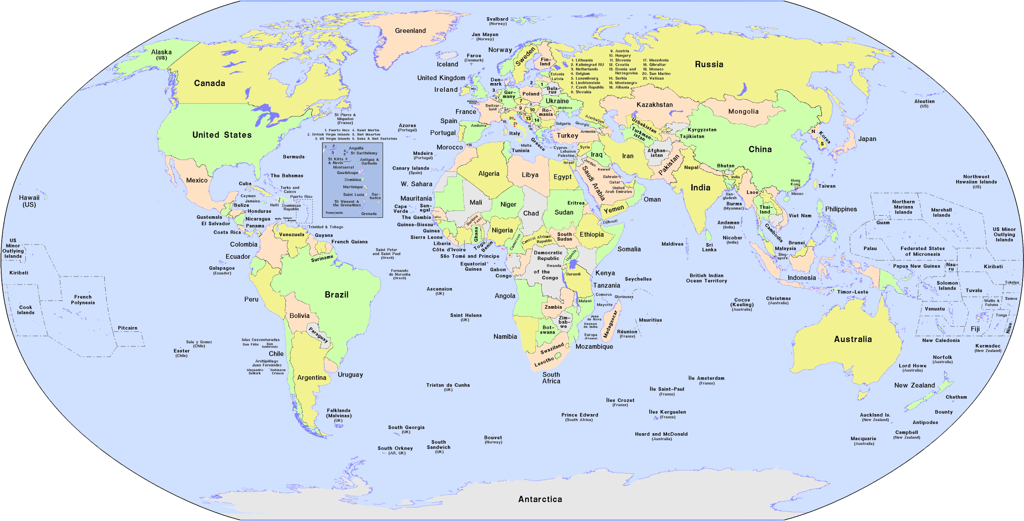
Global Office Locations
Cochabamba, Boliva
Sao Paulo, Brazil
Chihuahua, Mexico
Reading, England
Pretoria, South Africa
New Delhi, India
Melbourne, Australia
Singapore, Singapore
Shanghai, China

Slide 4
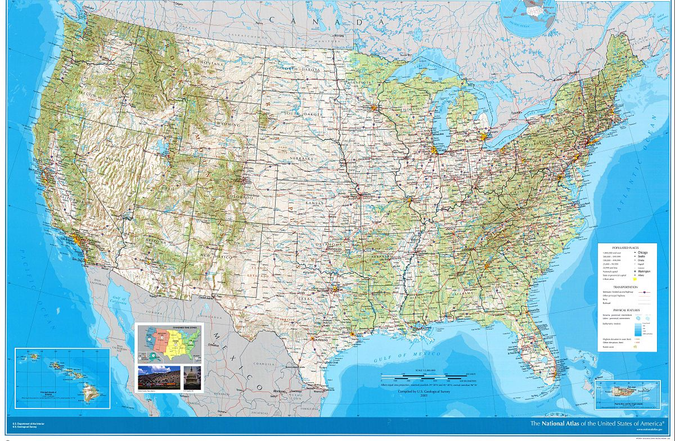
Some Office Locations in US and Canada

Slide 5

Our Services
Data and Analytics:
Data Analytics Consulting: Tailored strategies to meet your unique business needs.
Advanced Data Analytics: Cutting-edge techniques to uncover hidden patterns and trends.
Data Visualization: Interactive dashboards and visual tools to make data easily understandable.
Data Transformation: Seamless integration and transformation of data from various sources.
Enterprise Data Management: Robust solutions for managing and securing your data.
Business Intelligence: Tools and techniques to turn data into strategic assets.
Data Governance: Ensuring data quality, compliance, and security.
Cyber Security:
Threat Detection and Response: Continuous monitoring and rapid response to potential threats.
Vulnerability Assessments: Identify and mitigate security weaknesses before they can be exploited.
Security Audits: Ensure compliance with industry standards and regulations through thorough reviews.
Incident Management: Expert handling of security breaches to minimize impact and recovery time.
Data Encryption: Protect sensitive information with cutting-edge encryption technologies.
Network Security: Secure your network infrastructure against unauthorized access and attacks.

Slide 6
Our Services
ERP Support:
24/7 Technical Support: Round-the-clock assistance to resolve any issues promptly.
Customization and Integration: Tailored solutions to fit your unique business needs and seamless integration with other systems.
Data Migration: Secure and efficient data migration services to transition your data without disruption.
Compliance and Security: Ensuring your ERP system meets industry standards and is protected against threats.
Application Development:
Custom Application Development: Tailored solutions to meet your unique business needs.
Mobile App Development: Cutting-edge mobile applications for iOS and Android platforms.
Web Application Development: Responsive and scalable web applications to enhance your online presence.
UI/UX Design: Intuitive and engaging designs that provide an exceptional user experience.
Application Maintenance and Support: Ongoing support to ensure your application runs smoothly and efficiently.
API Integration: Seamless integration with third-party services and systems.
Cloud-Based Solutions: Scalable and secure cloud applications to support your business growth.

Slide 7

Our Services
Cloud Services:
Cloud Migration: Seamlessly transition your existing infrastructure to the cloud with minimal disruption.
Cloud Management: Comprehensive management services to ensure your cloud environment runs smoothly and efficiently.
Cloud Security: Advanced security measures to protect your data and applications from threats.
Hybrid Cloud Solutions: Combine the best of both worlds with our hybrid cloud offerings.

Slide 8

NOS Technical Services delivers key resources to help solve your IT staffing needs though our…
Staffing Services
Project Services
Managed Services
Consulting Services
Whether you are looking for a resources to provide expertise in technology, functional analysis, cyber security or technical support NOS Technical Services is here help.

Slide 9




Staffing Services
We understand that the right talent can make all the difference. Our comprehensive staffing solutions are designed to connect you with top-tier professionals who align perfectly with your business needs.
Expert Matching:
Industry Expertise
Speed and Efficiency
Ongoing Support
We use advanced algorithms and personalized assessments to find candidates who are the best fit for your company culture and job requirements.
Our team has extensive experience across various sectors, ensuring we understand the unique challenges and opportunities in your field.
We streamline the hiring process, saving you time and resources while maintaining high-quality standards.
From initial placement to long-term success, we provide continuous support to both clients and candidates.
Consulting : Providing resources that help you streamline business processes, data governance and project management standards.
Contract, Contract to Hire Perm Placement : Providing resources with specific technical expertise, subject matter expertise or management expertise.

Slide 10
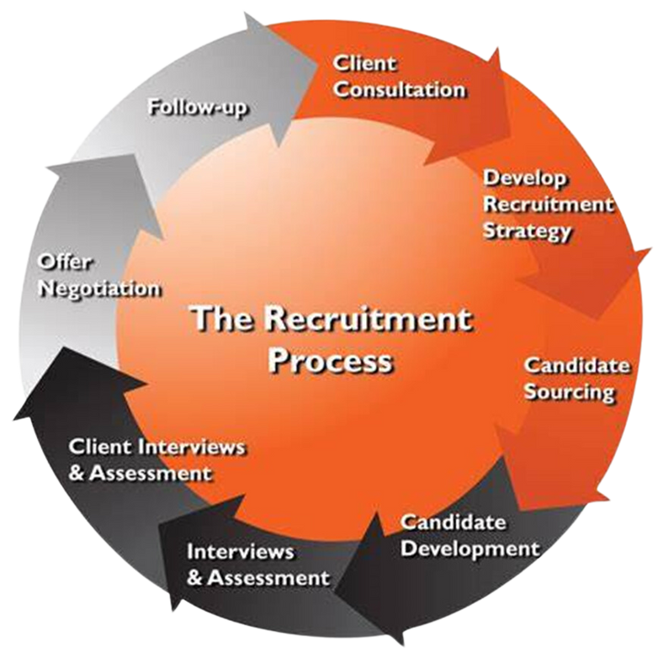
Staffing Approach
1. Job Description Review : Having an intake call with client manager to qualify our client’s staffing requirements is one of the first steps in resources quality candidates.
2. Candidate profiling and assessment : Candidates are identified and evaluated against our client’s job descriptions.
3. Technical screening and reference checks : Selected candidates must submit to drug screens, background checks and manager references to ensure fit and quality.
4. On- boarding and continuous care : We support our resources from beginning to end…from walking them on to their assignment day one to walking them off the project at the conclusion of their assignment

Slide 11
Our Services
Data and Analytics:
Data Analytics Consulting: Tailored strategies to meet your unique business needs.
Advanced Data Analytics: Cutting-edge techniques to uncover hidden patterns and trends.
Data Visualization: Interactive dashboards and visual tools to make data easily understandable.
Data Transformation: Seamless integration and transformation of data from various sources.
Enterprise Data Management: Robust solutions for managing and securing your data.
Business Intelligence: Tools and techniques to turn data into strategic assets.
Data Governance: Ensuring data quality, compliance, and security.
Cyber Security:
Threat Detection and Response: Continuous monitoring and rapid response to potential threats.
Vulnerability Assessments: Identify and mitigate security weaknesses before they can be exploited.
Security Audits: Ensure compliance with industry standards and regulations through thorough reviews.
Incident Management: Expert handling of security breaches to minimize impact and recovery time.
Data Encryption: Protect sensitive information with cutting-edge encryption technologies.
Network Security: Secure your network infrastructure against unauthorized access and attacks.

Slide 12


Project Services
Transform Your Vision into Reality with Our Project Services!
We specialize in delivering top-notch project management solutions tailored to your unique needs. Whether you’re launching a new product, streamlining operations, or expanding your business, our expert team ensures every project is executed flawlessly from start to finish.
Expertise:
Our seasoned professionals bring years of experience across various industries.
Customization:
We tailor our services to fit your specific goals and requirements.
Efficiency:
We use the latest tools and methodologies to ensure timely and cost-effective delivery.
Support:
From planning to execution, we provide continuous support and updates.
Ready to take your projects to the next level? Contact us today and let’s make your vision a reality!

Slide 13

Managed Services
Elevate Your Business with Our Managed Services!
We provide comprehensive managed services designed to optimize your IT infrastructure and enhance your business operations. Our expert team ensures your systems run smoothly, securely, and efficiently, allowing you to focus on what you do best.
Proactive Monitoring:
Security:
We continuously monitor your systems to prevent issues before they arise.
Our robust security measures protect your data and ensure compliance with industry standards.
Cost Efficiency:
Expert Support:
Reduce operational costs with our scalable solutions tailored to your needs.
Our dedicated support team is available 24/7 to assist with any technical challenges.
Transform your IT operations and drive business growth with our managed services

Slide 14

Consulting Service
Unlock Your Business Potential with Our Consulting Services!
We provide expert consulting services designed to help your business thrive. Our team of seasoned consultants brings a wealth of experience and industry knowledge to address your unique challenges and drive sustainable growth.
Tailored Solutions:
Industry Expertise:
We customize our strategies to meet your specific business needs and goals.
Our consultants have deep expertise across various sectors, ensuring you receive the best advice and insights.
Proven Results:
Collaborative Approach:
We have a track record of delivering measurable improvements and successful outcomes for our clients.
We work closely with your team to ensure seamless integration and implementation of our recommendations.
Ready to take your business to the next level?

Slide 15
Why use NOS Technical Services
Using NOS Technical Services can provide numerous benefits for your business:
Expertise and Precision:
Efficiency and Speed:
NOS Technical Services offers specialized contract recruitment, ensuring you get the right talent for your specific needs. The NOS team brings a wealth of experience and industry knowledge to every project.
Their advanced methodologies and tools streamline the recruitment process, saving you time and resources.
Security and Compliance:
Customized Solutions:
They implement stringent security measures to protect your data and ensure compliance with industry standards.
NOS Technical Services tailors their offerings to meet the unique requirements of your business, providing a personalized approach that aligns with your goals.
By leveraging NOS Technical Services, you can enhance your operational efficiency, reduce costs, and focus on your core business activities.

Slide 16


Slide 17


Thank You For Your Attention

